Slide 1
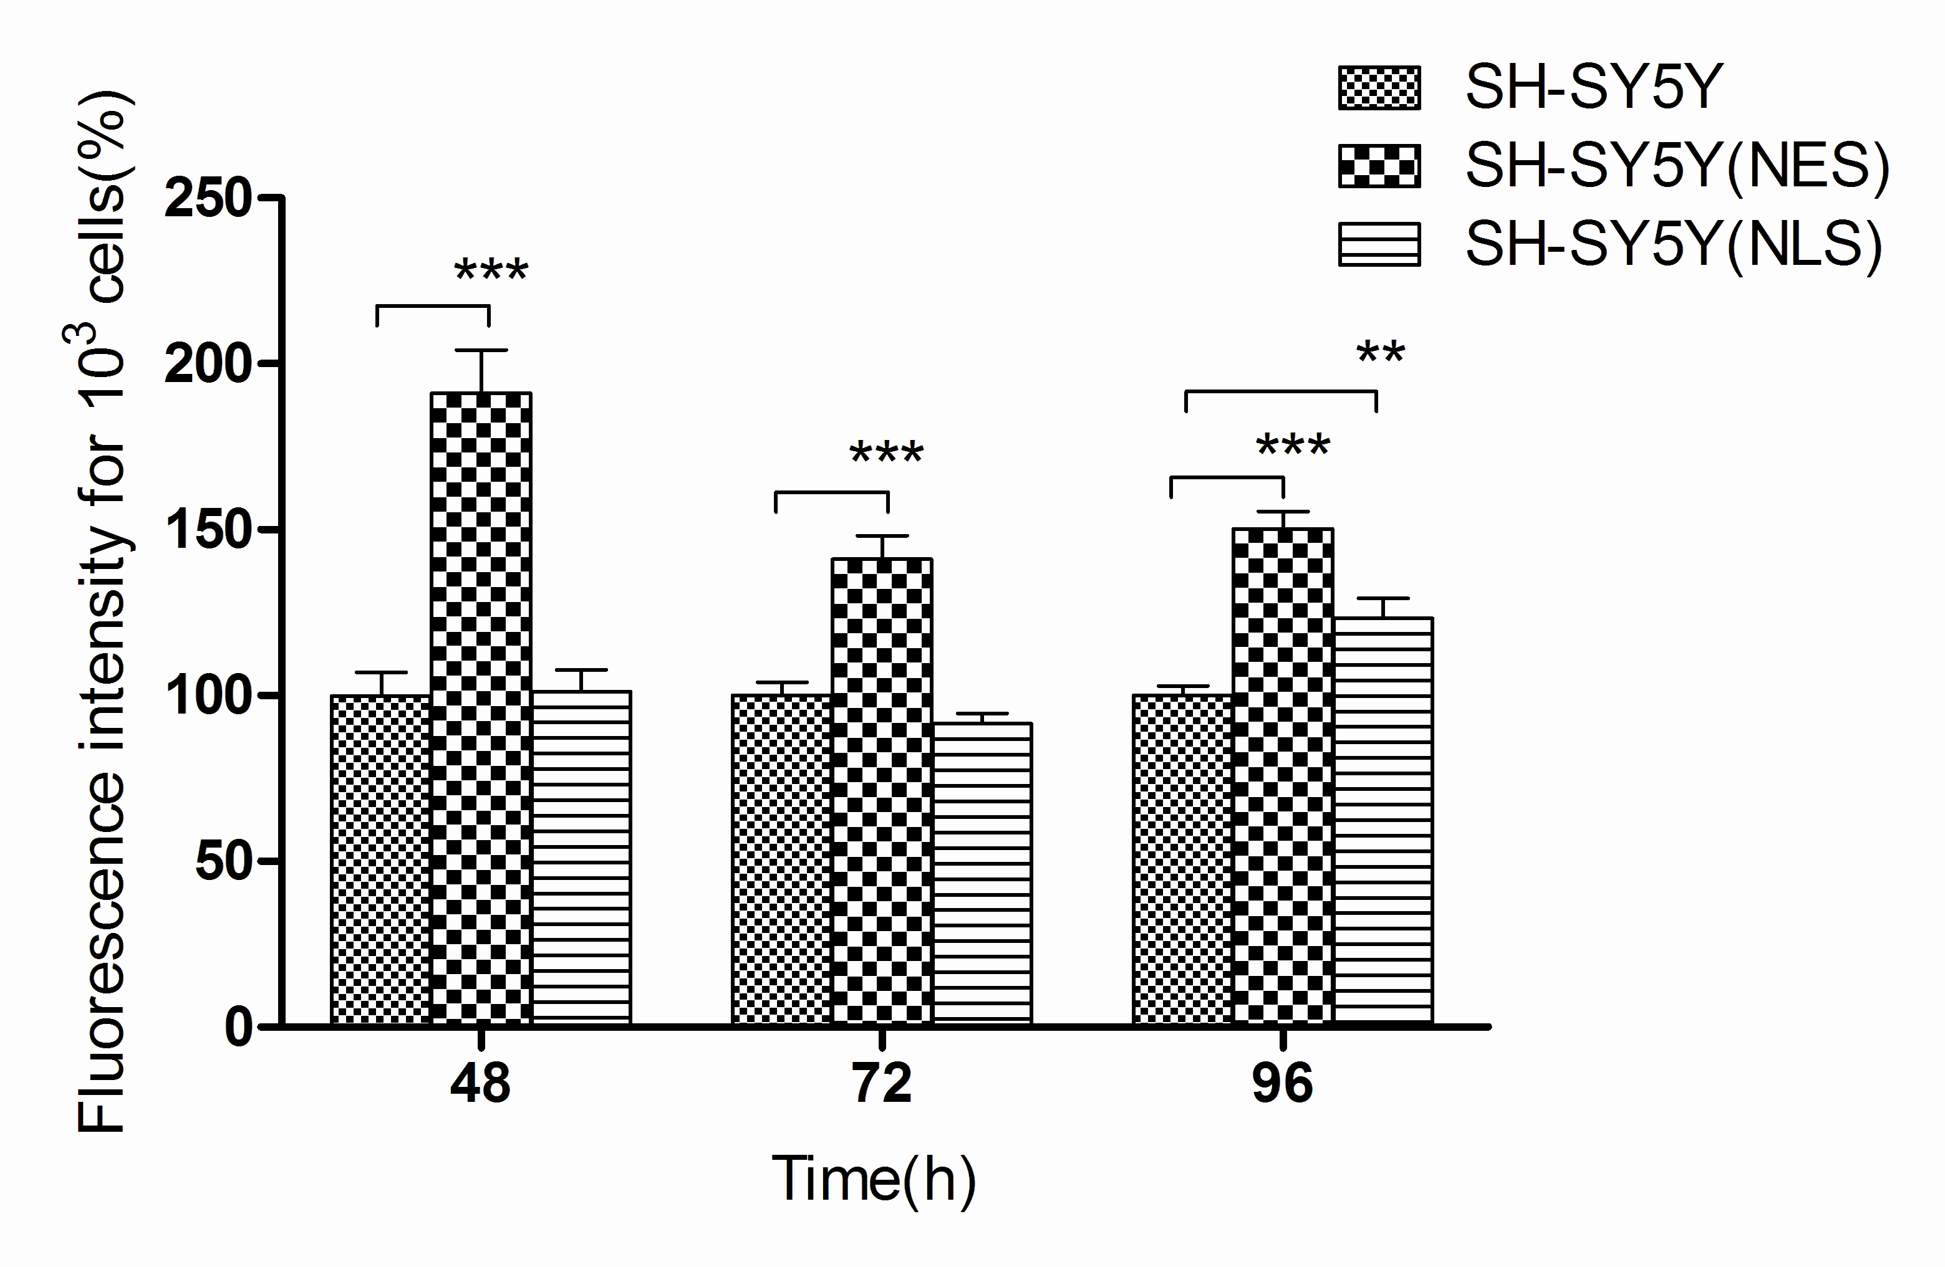
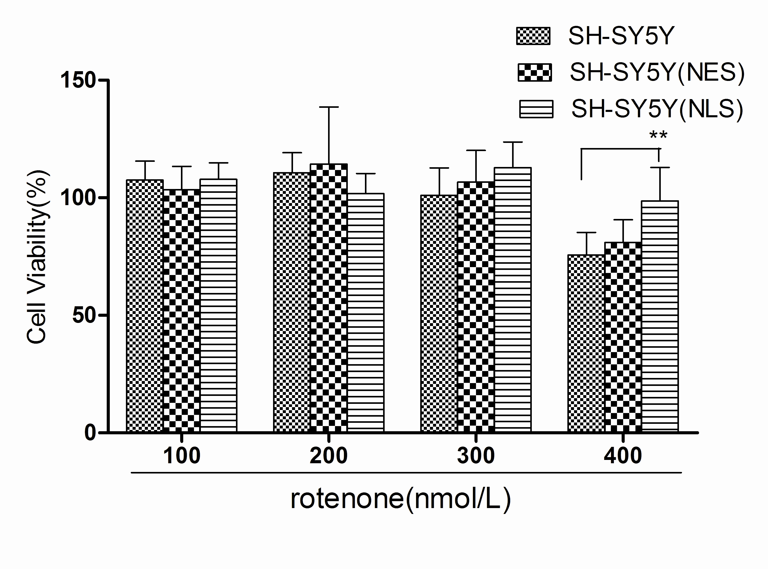
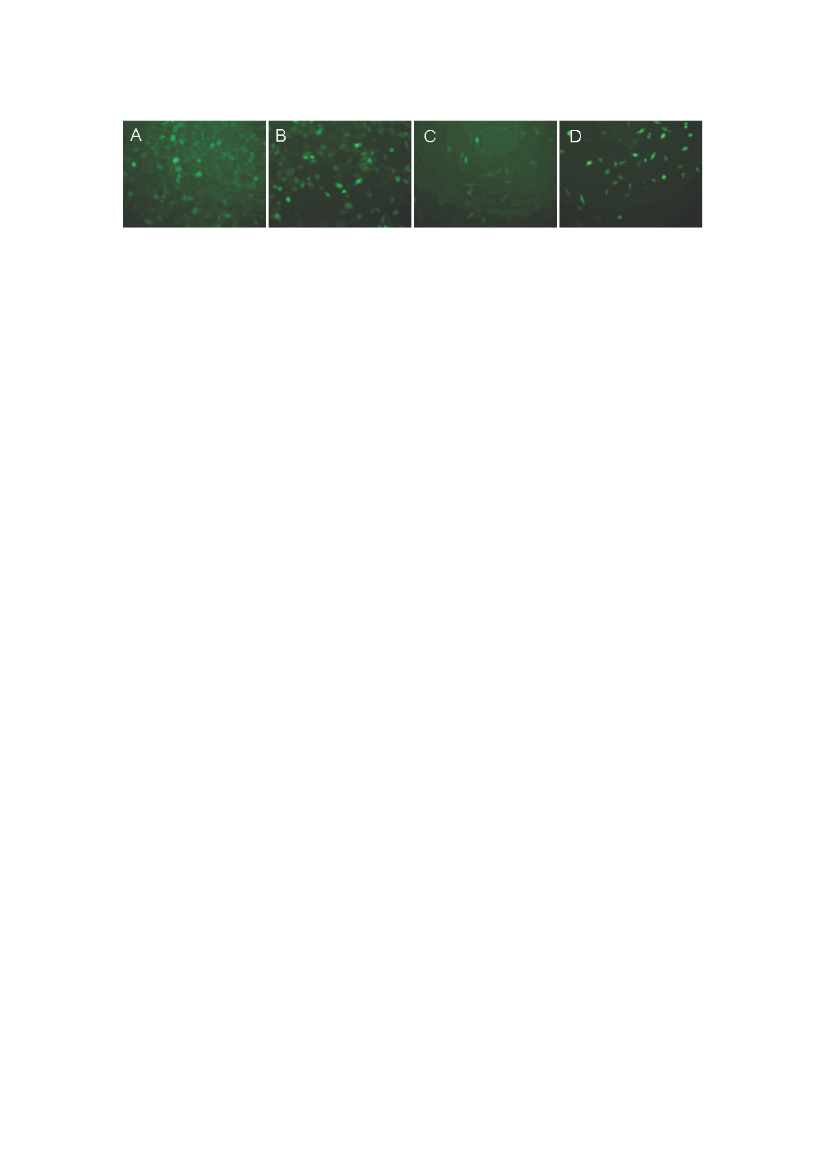
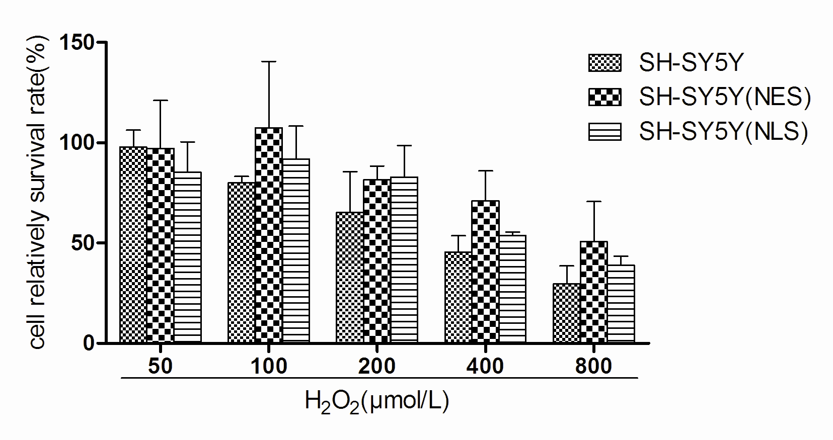
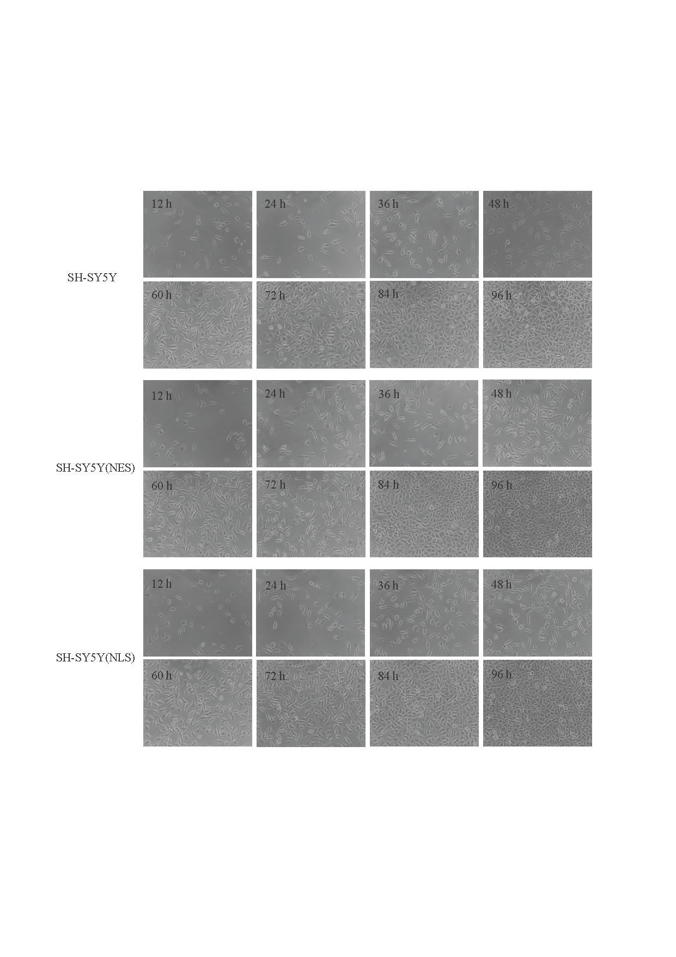
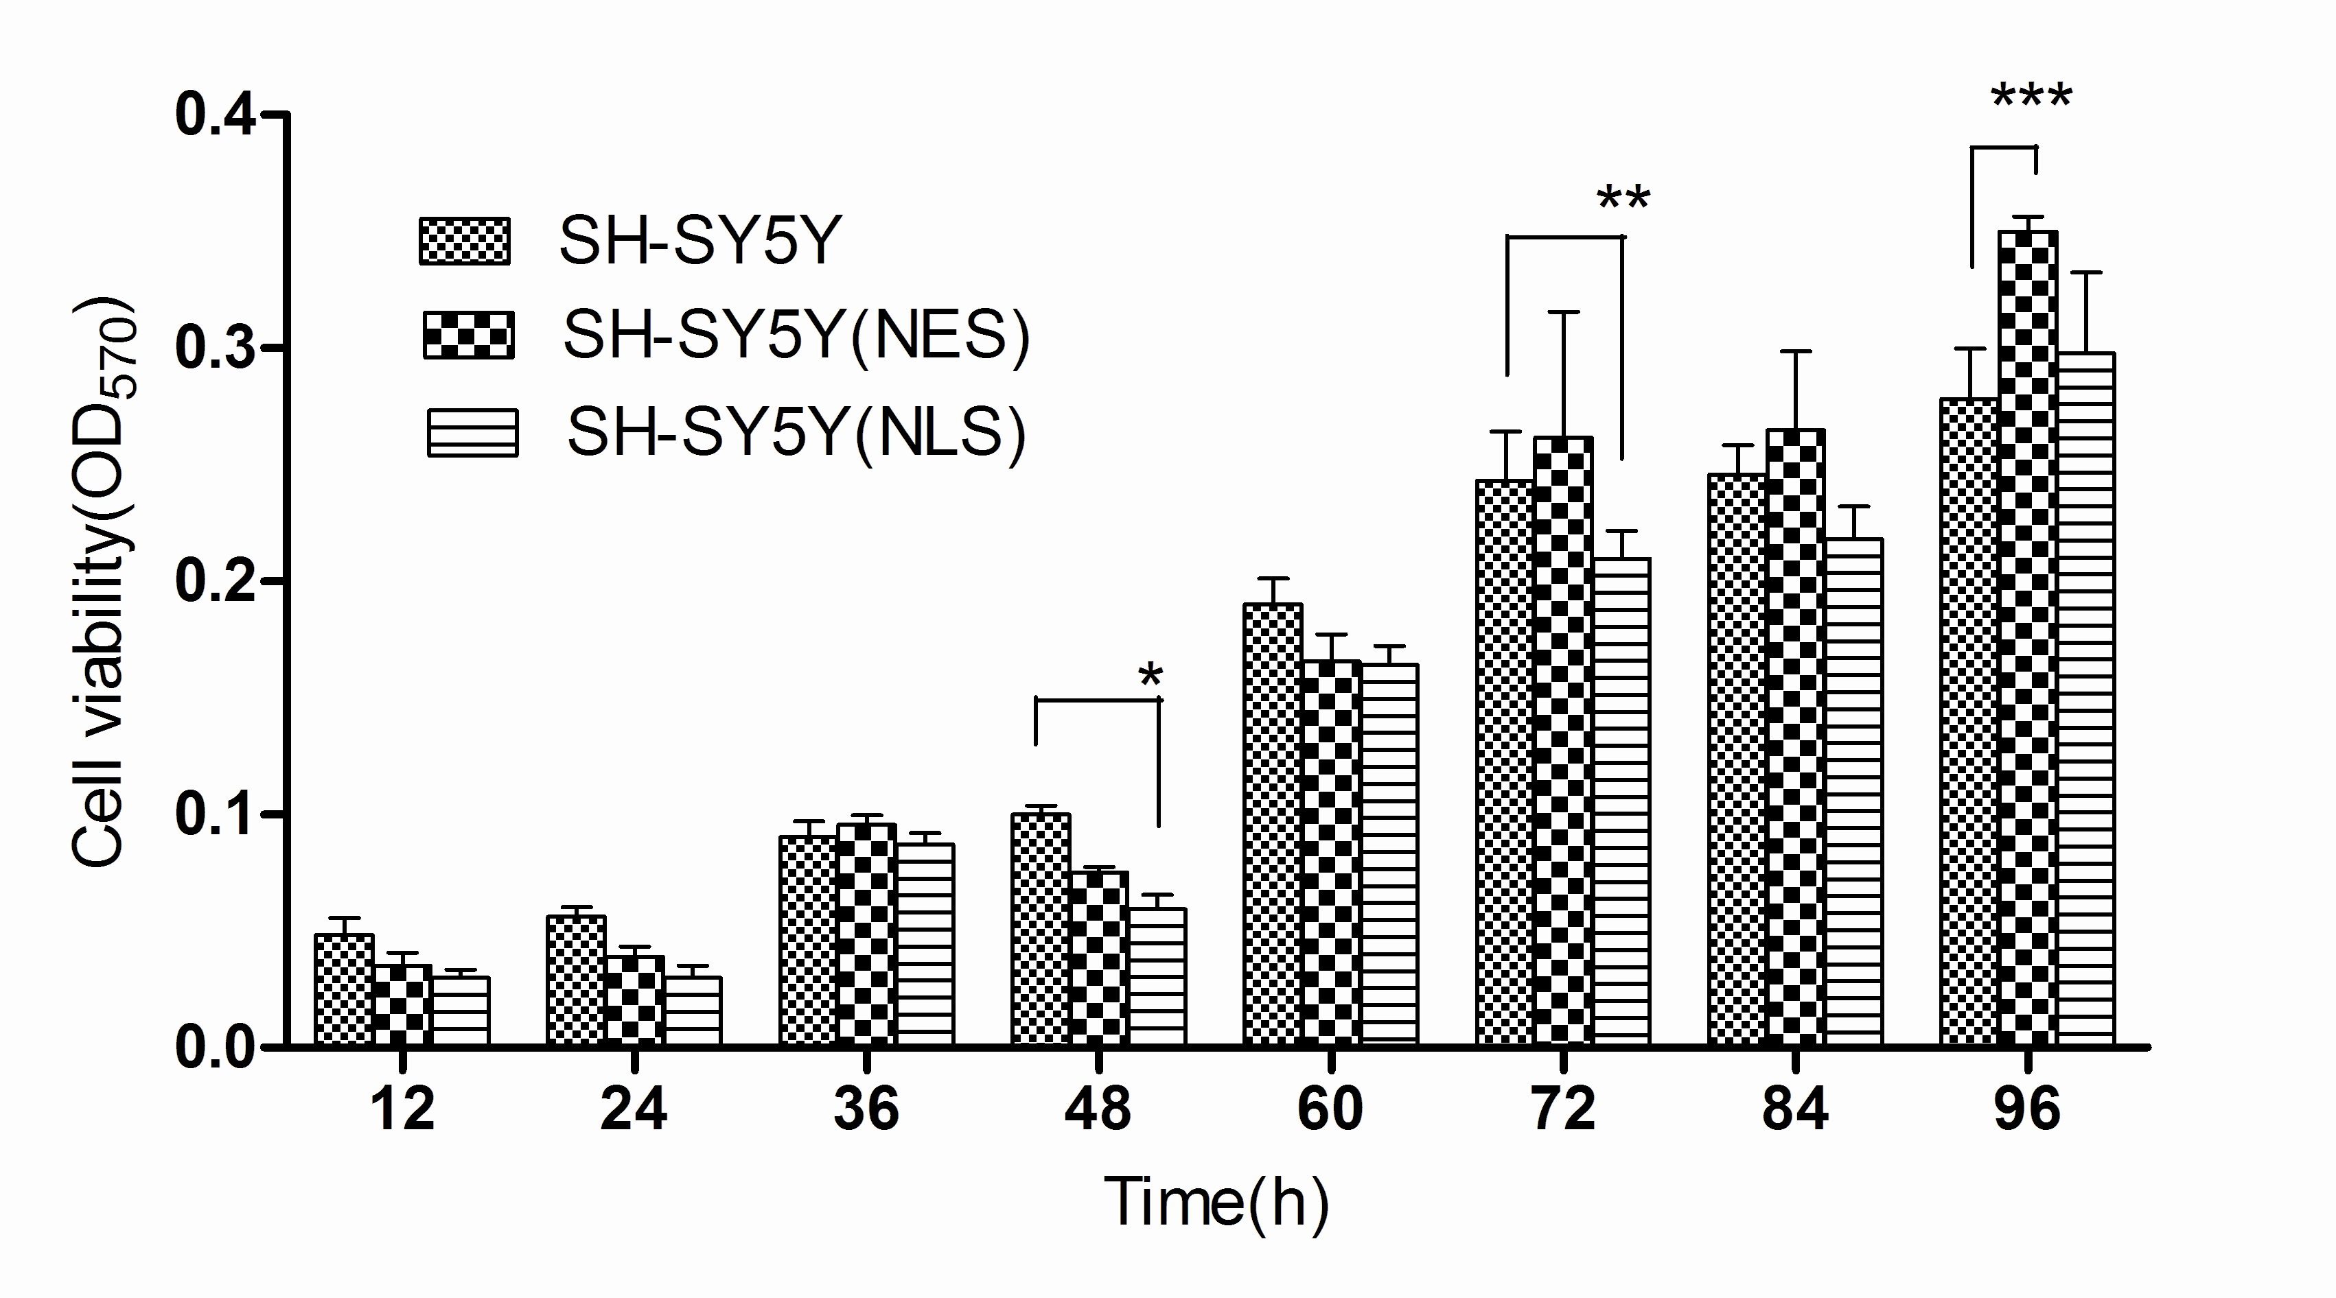
The 1st Jiangsu Foreign Postgraduate Research Symposium
Effects of cytoplasm localized or nuclear localized overexpression α-synuclein on SH-SY5Y cells
Xia juan1, Gao Jing1*, Xiong yu-yun2, Qiu jing 1,Ma rui3, Qian jin-jun4
1School of Pharmacy, 2School of Medical Science and Laboratory Medicine, 3School of Medicine, 4Fourth People's Hospital of Zhenjiang. Jiangsu University, Zhenjiang, 212013,China
Introduction
The gene of α-synuclein is the first found related to Parkinson's disease. The expression and aggregation of α-synuclein is one of the main pathological characteristics, and at the same time mitochondrial disfunction is also found as the central link to PD. Studies have found α-synuclein’s nuclear location performance for the toxic effects by the histone acetylation. So we infer that α-synuclein’s nuclear location - nuclear acetylation imbalance -mitochondria disfunction could be a key mechanism of PD pathogenesis.
Methods
Fig 4 Mitochondrial amount changes of cytoplasm localized or nuclear localized overexpression α-synuclein on SH-SY5Y cells（n=5；**P＜0.01 ,***P＜0.001 vs
SH-SY5Y）
The recombinant plasmid PLVU-SNCA-NES(NLS)-2A-EGFP was transfected into SH-SY5Y cells by lentivirus vector. Then the expression of reporter gene EGFP is detected by fluoresce-
nce microscopy ; MTT to analyze the viability of SH-SY5Y, SH-SY5Y(NES) and SH-SY5Y(NLS) cells; MitoTraker Red to detect the amount of mitochondria. After transfected with the recombinant plasmid PLVU-SNCA-NES(NLS)-2A-EGFP by lentivirus vector for 48 h, the expression of EGFP is detected.
Results
Fig 5 Cell viability of SH-SY5Y、SH-SY5Y（NES）、SH-SY5Y(NLS)treated by rotenone. （n=5；**P<0.01）
Fig1 EGFP expression in the SH-SY5Y cells after infection under fluorescent microscope（×200）A, B: EGFP expression in the SH-SY5Y cells after infection 48 h；C, D: EGFP expression in the stable genetic SH-SY5Y after infection
A: PLVU-SNCA-NES-2A-EGFP B: PLVU-SNCA-NLS-2A-EGFP
C: SH-SY5Y(NES) D: SH-SY5Y(NLS)
Fig 6 Cell viability of SH-SY5Y、SH-SY5Y（NES）、SH-SY5Y(NLS) treated by H₂O₂. (n=5)
Conclusions
The results showed that both the stable genetic SH-SY5Y(NES) and SH-SY5Y(NLS) were established. The viability of SH-SY5Y(NES) cells is significantly
enhanced compared with normal control at 96 h, and the amount of mitochondria in SH-SY5Y(NES) is significantly increased at 24 h, 48, 96 h, the increasing rate is 91.18 %, 41.15 %, 50.21 % respectively. While the viability of SH-SY5Y(NLS) is decreased following the transfection, it is surprising to find that following the administration of 400 nmol/L rotenone, the viability of SH-SY5Y(NLS) is much higher than SH-SY5Y cells. But with the treatment of 50~800 μmol/L H₂O₂, there is no significant difference in survival rate occurred among all kinds of cells. In summary,
α-synulein cytoplasm overexpression may enhance the
viability of SH-SY5Y cells .α-synuclein nuclear localization overexpression can also change the viability of SH-SY5Y cells.
Fig 2 Morphology of SH-SY5Y, SH-SY5Y（NES）, SH-SY5Y(NLS) cells at different time points.
For further information Please contact email: jinggao@ujs.edu.cn.
Fig 3 Cell viability of SH-SY5Y、SH-SY5Y（NES）、SH-SY5Y(NLS) cells at different
time points.( n=8;*p <0.05 ,**p <0.01 ,***p <0.001 vs SH-SY5Y )

